Slide 1
SHAPES AND STRUCTURES: HOME FOR A HAMSTER
GRADE 1
LESSON PLAN
Notes:
Explain to the students that they will be seeing different types of structures (buildings, bridges, towers and tunnels). Their job is to find the geometric shapes engineers use to make things strong.

Slide 2
HOW IS THE CRANE DESIGNED TO BE STRONG?
Notes:
Notice how many small triangles fit inside a rectangle to create strength.

Slide 3
WHAT SHAPES DO YOU SEE?
Notes:
Look for triangles.
Notice how the beams look like “I”’s
Ask students how the metal might be connected?

Slide 4
WHAT SHAPES DO YOU SEE?
Notes:
Ask students why there would be triangles within triangles?

Slide 5
HOW CAN CURVED STRUCTURES BE MADE STRONG?
Notes:
Point out the supports under the bridge.
IF ABLE to source a wooden bridge:
Ask how the wood parts might be connected? What kind of joints could be strong?

Slide 6
CAN YOU FIND A SQUARE, RECTANGLE, RHOMBUS, OR TRAPEZOID?
Notes:
Encourage students to find as many shapes as possible.
Structural engineers design building to make sure they are safe for people to be in during natural disasters like earthquakes.
As a type of civil engineer, structural engineers design structures that will be strong and stable enough for people to use every day.

Slide 7
WHAT SHAPES DO YOU SEE?
Notes:
Ask students how engineers can use cables or ropes to make structures stronger?

Slide 8
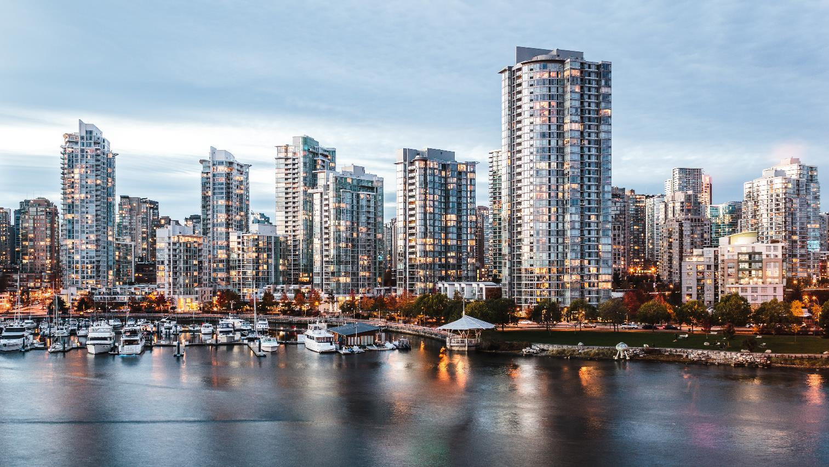
HOW ARE ENGINEERS AT WORK IN OUR COMMUNITY?

Slide 9
DESIGN YOUR HOME FOR A HAMSTER
Time to Design and Build!
How much space does a hamster need?
What size should the doorway be?
Is there space for the hamster to turn around?
Is there room for a food and water container?
Photo by Ricky Kharawala on Unsplash
Notes:
Your design Challenge: Think like an engineer and design a home for a hamster!
Introduce the challenge and group work expectations.
The aim of this activity is to build a home that would be safe for your hamster to live in.
Using the materials provided, you will work individually or in groups to put your hamster home together.

Slide 10
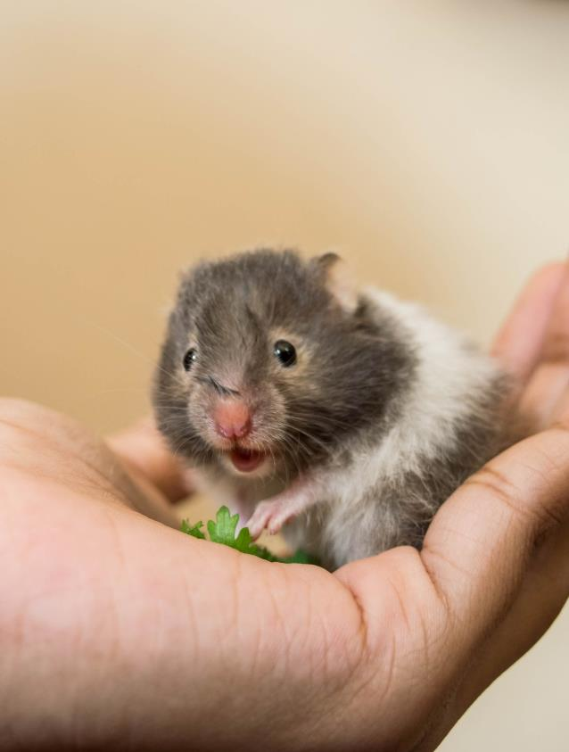
DESIGN YOUR HOME FOR A HAMSTER
Time to Reflect
What shapes made the strongest structure?
What materials worked well when building your hamster home?
What things did you focus on when designing your hamster home?
Photo by Finney on Unsplash
Notes:
Have students complete a gallery walk of each other’s hamster houses.
Ask reflection-based questions.
Identify how shapes are used to make a strong structure.

Slide 11
HOME FOR A HAMSTER
Lesson plan provided by Engineers and Geoscientists BC​
If you have more questions about engineering and geoscience visit the Engineers and Geoscientists BC website egbc.ca/youth​
Notes:
Engineers and Geoscientists BC is the regulatory body for engineering and geoscience.
If you have more questions about engineering and geoscience visit the Engineers and Geoscientists BC website egbc.ca/youth

